Slide 1
Website Accessibility BOCES Seminar June 2017

Slide 2
Web Accessibility
Web accessibility refers to the inclusive practice of removing barriers that prevent interaction with, or access to websites, by people with disabilities. When sites are correctly designed, developed and edited, all users have equal access to information and functionality.

Slide 3
OCR is cracking down on public school districts to ensure their websites are compliant
Proactive
First Steps
Guidelines
Identify Accessibility problems
Publish Web Policy and Procedures on Your Website
Notes:
OCR and US Department of Justice (DOJ) have been active
in investigating higher education institutions and K-12 public
schools for web accessibility to people with disabilities.
• Currently, the websites of at least 650 educational institutions
are subject to investigation by OCR.
‘ADVOCATE MOVES NEEDLE ON WEBSITE
ACCESSIBILITY’
• Marcie Lipsitt, of Franklin, MI., has personally filed some 500
complaints with OCR advocating for web accessibility for
students with disabilities. She reviews school districts’ websites
one by one using her iPad software, looking for barriers that
would prevent access.
• Education Week, Dec. 1, 2016

Slide 4
The U.S. department of education does play a role with website accessibility
The Office for Civil Rights (OCR) of the United States Department of Education and the Civil Rights Division of the United States Department of Justice are responsible for investigating complaints of disability discrimination.
OCR enforces Section 504 of the Rehabilitation Act and Title II of the Americans with Disabilities Act and is responsible for investigating a public school district’s alleged violation of these laws.
Notes:
OCR takes the position that Title II and Section 504’s equal
access requirements extends to school districts’ websites.
OCR’S 2010 “DEAR COLLEAGUE” LETTER
SETS THE TONE
• In 2010, OCR sent a Dear Colleague Letter to college and
university presidents letting them know what their accessibility
obligations were to college students with respect to an
electronic reader they were using.
• OCR instructed that reasonable accommodations or
modifications need to be made so that a student can acquire
the same information, engage in the same interactions, and
enjoy the same services as sighted students with substantially
equivalent ease of use in the event a device is not readily
accessible to students with disabilities.
OCR EXPANDS SCOPE TO K-12 SCHOOLS
• In May 2011, OCR followed up with a similar Dear Colleague
Letter that clarified that the question of equal access under the
ADA and Section 504 is much broader than the of use of a
specific electronic reader and includes all areas of online
content.
• Moreover, elementary and secondary students must also
receive the same benefits, services, and opportunities afforded
by online technology as their non-disabled peers.

Slide 5
Guidelines, Standards & Accessibility Laws Updated 508 Standards beginning January 18, 2018
Emergency Notifications
Notices of Benefits
Employment opportunities
Surveys, questionnaires
Web based intranets
Educational training materials
Policy announcements
Notes:
Updated standards begin on January 18, 2018 – like original include a full range of public-facing content including websites, documents, media, blog posts, and social media sites
Any component must be updated to conform to the updated 508 standards

Slide 6
Some Examples
Meaningful Sequence Contrast Link Purpose Multiple Ways Error Suggestion
Notes:
Provides for a reasonable and logical reading order when using assistive technology
Contrast minimum – specified contrast between foreground and background of text and images of text
Provides the purpose of any link is understandable
Provides for two or more means to locate content
Provides that the system makes suggestions for correction when errors are automatically detected

Slide 7
Recent headlines
Berkeley removing 20K free videos after DOJ ruling, closed-captioning complaint (March 7, 2016)
Lynchburg area schools scramble to meet online ADA compliance (January 28, 2017)
Websites under scrutiny for compliance with disabilities act (February 28, 2017)
Omaha Steaks among companies facing ADA compliance lawsuits over websites (February 26, 2017)

Slide 8
WHEN THE OFFICE OF CIVIL RIGHTS CALLS WILL YOU BE READY?

Slide 9
What is ADA Compliance?
The Americans with Disabilities Act (ADA) was first passed in 1990.
The Americans with Disabilities Act (ADA) prohibits discrimination against people with disabilities in employment, transportation, public accommodation, communications, and governmental activities. The ADA also establishes requirements for relay services.
Nearly Twenty years of the 1990 ada act, the US Department of Justice released an update called the 2010 ADA Standards for Accessible Design.

Slide 10
Section 508
Section 508, an amendment to the United States Workforce Rehabilitation Act of 1973, is a federal law mandating that all electronic and information technology developed, procured, maintained, or used by the federal government be accessible to people with disabilities.
Just this year on January 9, the u.s. access board updated section 508 of the Rehablitation Act and Setion 255 of the Communications Act
To align with wcag 2.0
Better defines the scope of what is electronic content
And addresses content authoring
Date to know 18 January 18
Federal site must be compliant
Organization that receive federal funding
However the department of education needs to let us all know

Slide 11
Guidelines 508 – January 2018
Major changes include:
Incorporating WCAG 2.0
Specifying types of non-public facing electronic content that must comply
Assistive Technology
Cognitive, Language and Learning Disabilities

Slide 12
Managing an OCR Complaint
Legal Counsel
Review web accessibility concerns
Respond to OCR Request in a timely fashion
Vendor
Notes:
Share with district legal counsel
Run a quick and simple automated accessibility test on web pages noted in OCR complaint
Letter from OCR will have an expected response time – important to comply
Contact eSchoolView for guidance

Slide 13
• Designate a web accessibility coordinator • Provide training • Ensure all new content is published accessible • Develop and implement a corrective action plan • Monitor compliance
Proactive not Reactive Avoiding OCR
Notes:
Define who in the organization is responsible for monitoring and reporting on web accessibility
Provide web accessibility training for all appropriate personnel – start of school year perfect time!
Make sure all new web content is accessible to people with disabilities
Develop a corrective action plan to prioritize and fix any errors found WCAG 2.0 A, AA, and AAA reports
Run regular audits on your site

Slide 14
• Establish Internal Accessibility Policy and Guidelines • Web Accessibility Exception Procedure • Social Media Accessibility Procedure
Proactive not Reactive Avoiding OCR

Slide 15
Does it matter?
In addition to complying with state and federal laws and policies, ensuring your parent communications are accessible is important both as a matter of equality and for reaching your viewers.
According to the U.S. Census Bureau, nearly 57 million Americans have some type of disability, with 31 million having a mobility disability and 16 million a sensory disability involving sight or hearing.
Ensuring that your e-mails, mobile apps and websites are accessible to all is critical for effective communications.

Slide 16
Are there standards or laws for accessibility that school districts must comply with?
The simply answer is yes…
The legal Answer is yes but is a bit more complicated…
General Guidelines
When in doubt…Consult with your district’s legal counsel

Slide 17
What is Accessibility
Recognize accessibility applies to students parent and employees
Just as your brick & mortar location must be accessible to all employees and students, your website should also be accessible
Accessibility generally means equal or equivalent access by a person with a disability.
Technology is accessible if it can be used as effectively by people with disabilities as by those without.
Notes:
THE AMERICANS WITH DISABILITIES ACT
(ADA)
• Title II of the ADA prohibits discrimination on the “basis of
disability in all services, programs, and activities provided to the
public by State and local governments, except public transportation
services.”
• Individuals with disabilities must have equal access to the recipients’
programs, services, or activities unless doing so would fundamentally
alter the nature of the programs, services, or activities, or would
impose an undue burden. 28 C.F.R. § 35.164.
• Title II applies to K-12 public schools regardless of whether they
receive federal funds.
• Title II Regulations include specific communication requirements
stating that public entities must take appropriate steps to ensure that
communications with applicants, participants, members of the
public, and companions with disabilities are as effective as communications with others.
THE EVERY STUDENT SUCCEEDS ACT(ESSA)
• Website accessibility has particular relevance to ESSA.
• ESSA permits school districts and state boards of education to
use their websites to provide public notice for things such as
school report cards or proposed changes to policy.
• If those notices can't be read by a portion of the relevant
audience, that's going to be an accessibility problem.

Slide 18
Does accessibility mean different things for different people?
Yes…
it depends on who you are, what you do,
what you use and your environment
For a blind user, it might mean having technology work with the screen reader software.
To a color-blind user, a website is accessible when color isn’t used to convey meaning and the contrast between colors is strong. And a user with mobility impairment sees accessibility as being able to use a website with limited fine motor skills and to navigate without needing a mouse.
Notes:
Types of disabilities can impact one’s ability to access the web.
There are 4 different types of disabilities that can affect the way people use and interact with websites,
Visual, Auditory, Mobility and Dexterity and Cognitive.

Slide 19
Accessibility further defined
Web sites which are perfectly accessible to fully-abled people may be impossible for people with disabilities to access.
For example, that beautiful new school website that your tech department just created may be impossible for a person using screen reading technology to navigate; particularly if they are blind/low vision or have a specific learning disability.
Those “frames” or neat drop-down Java menus on your site may be impossible to use via voice command software.
If you are using “streaming audio” online for student programming or video conferencing events it may be impossible for a deaf person to hear.

Slide 20
Considerations for Functional Accessibility
use by people who may have severe or moderate visual impairment
use by people who may be colorblind
use by people who may be deaf or hard of hearing
use by people who may have motor disabilities
use by people who may have cognitive disabilities
Notes:
How disabilities affect people’s ability to perceive and use website/pages.
Visual Disabilities – blindness, low vision, color blindness
Tools used Screen Readers – Braille displays
Auditory – deafness or hard of hearing
Tools used closed or open caption transcripts.
Ambulatory – Physical disabilities or fine motor skills
Use Keyboard only, speech to text software
Cognitive. Language disabilities - difficulty reading or understand written text. (example per with Dyslexia)
Thoughtful layout and organization of web content
Text to speech software

Slide 21
4 Categories Of Disability
Sight disability – for example, blind, partially sighted or color blind
Hearing disability – for example, deaf or hard of hearing
Motor disability – for example, problems with motor skills or slow movement
Cognitive disability – for example, learning difficulties or problems with concentration or reading
This does not suggest that all disabilities fall into these categories or that they are mutually exclusive.
(From How to Meet the Web Content Accessibility Guidelines 2.0 - Luke McGrath)
Notes:
How disabilities affect people’s ability to perceive and use website/pages.
Visual Disabilities – blindness, low vision, color blindness
Tools used Screen Readers – Braille displays
Auditory – deafness or hard of hearing
Tools used closed or open caption transcripts.
Ambulatory – Physical disabilities or fine motor skills
Use Keyboard only, speech to text software
Cognitive. Language disabilities - difficulty reading or understand written text. (example per with Dyslexia)
Thoughtful layout and organization of web content
Text to speech software

Slide 22
Report a Website Accessibility Issue
Notes:
Provide a way for to report – before it becomes and OCR issue
Families, students – yearly check in’s
Promptly fix any problems reported and follow up

Slide 23
How are individuals with disabilities able to use websites and related online technology?
A variety of assistive technologies, devices, software, or techniques are available and designed to assist individuals with disabilities.
Including: screen readers, refreshable Braille displays, screen magnifiers, onscreen or special keyboards, and word prediction software.
Accessible websites are designed to work in conjunction with these assistive technologies.

Slide 24
What are the key elements of an accessible website?
Here are a few examples:
All information on an accessible website is explicitly labeled, using alternative text for each item, including images and image links.
Visitors should be able to navigate an accessible site with the keyboard and not need to use the mouse.
An accessible site has focus control, providing the user the ability to control keyboard and reading focus within a webpage or application.

Slide 25
What website elements can “break” accessibility?
There are a number of types of digital content or other website elements that can hurt accessibility.
Some examples include:
PDF or other document files that are formatted so a screen reader can’t read the text in logical order
video files that don’t have captions\external website content that is embedded into the website which itself may not be accessible.

Slide 26
Understanding Accessibility Issues
Technical – CMS/Templates
Content
Web pages have titles that describe topic or purpose
Color is not used as the only visual means of conveying information
Non-text content is presented with a text alternative

Slide 27
WCAG 2.0 checklist Level A (Beginner Guideline) | Summary
1.1.1 – Non-text Content | Provide text alternatives for non-text content
1.2.1 – Audio-only and Video-only (Pre-recorded) | Provide an alternative to video-only and audio-only content
1.2.2 – Captions (Pre-recorded) | Provide captions for videos with audio
1.2.3 – Audio Description or Media Alternative (Pre-recorded) | Video with audio has a second alternative
1.3.1 – Info and Relationships | Logical structure
1.3.2 – Meaningful Sequence | Present content in a meaningful order
1.3.3 – Sensory Characteristics | Use more than one sense for instructions
1.4.1 – Use of Color | Don’t use presentation that relies solely on color
1.4.2 – Audio Control | Don’t play audio automatically
2.1.1 – Keyboard | Accessible by keyboard only
2.1.2 – No Keyboard Trap | Don’t trap keyboard users
2.2.1 – Timing Adjustable | Time limits have user controls
2.2.2 – Pause, Stop, Hide | Provide user controls for moving content
2.3.1 – Three Flashes or Below | No content flashes more than three times per second
2.4.1 – Bypass Blocks | Provide a ‘Skip to Content’ link
2.4.2 – Page Titles | Use helpful and clear page titles
2.4.3 – Focus Order | Logical order
2.4.4 – Link Purpose (In Context) | Every link’s purpose is clear from its context
3.1.1 – Language of Page | Page has a language assigned
3.2.1 – On Focus | Elements do not change when they receive focus
3.2.2 – On Input | Elements do not change when they receive input
3.3.1 – Error Identification | Clearly identify input errors
3.3.2 – Labels or Instructions | Label elements and give instructions
4.1.1 – Parsing | No major code errors
4.1.2 – Name, Role, Value | Build all elements for accessibility

Slide 28
WCAG 2.0 checklist Level AA (Intermediate Guideline) | Summary
1.2.4 – Captions (Live) | Live videos have captions
1.2.5 – Audio Description (Pre-recorded) | Users have access to audio description for video content
1.4.3 – Contrast (Minimum) | Contrast ratio between text and background is at least 4.5:1
1.4.4 – Resize Text | Text can be resized to 200% without loss of content or function
1.4.5 – Images of Text | Don’t use images of text
2.4.5 – Multiple Ways | Offer several ways to find pages
2.4.6 – Headings and Labels | Use clear headings and labels
2.4.7 – Focus Visible | Ensure keyboard focus is visible and clear
3.1.2 – Language of Parts | Tell users when the language on a page changes
3.2.3 – Consistent Navigation | Use menus consistently
3.2.4 – Consistent Identification | Use icons and buttons consistently
3.3.3 – Error Suggestion | Suggest fixes when users make errors
3.3.4- Error Prevention (Legal, Financial, Data) | Reduce the risk of input errors for sensitive data

Slide 29
WCAG 2.0 checklist Level AAA (Advanced Guideline) | Summary
1.2.6 – Sign Language (Pre-recorded) | Provide sign language translations for videos
1.2.7 – Extended Audio description (Pre-recorded) | Provide extended audio description for videos
1.2.8 – Media Alternative (Pre-recorded) | Provide a text alternative to videos
1.2.9 – Audio Only (Live) | Provide alternatives for live audio
1.4.6 – Contrast (Enhanced) | Contrast ratio between text and background is at least 7:1
1.4.7 – Low or No Background Audio | Audio is clear for listeners to hear
1.4.8 – Visual Presentation | Offer users a range of presentation options
1.4.9 – Images of Text (No Exception) | Don’t use images of text
2.1.3 – Keyboard (No Exception) | Accessible by keyboard only, without exception
2.2.3 – No Timing | No time limits
2.2.4 – Interruptions | Don’t interrupt users
2.2.5 – Re-authenticating | Save user data when re-authenticating
2.3.2 – Three Flashes | No content flashes more than three times per second
2.4.8 – Location | Let users know where they are
2.4.9 – Link Purpose (Link Only) | Every link’s purpose is clear from its text
2.4.10 – Section Headings | Break up content with headings
3.1.3 – Unusual words | Explain any strange words
3.1.4 – Abbreviations | Explain any abbreviations
3.1.5 – Reading Level | Users with nine years of school can read your content
3.1.6 – Pronunciation | Explain any words that are hard to pronounce
3.2.5 – Change on Request | Don’t change elements on your website until users ask
3.3.5 – Help | Provide detailed help and instructions
3.3.6 – Error Prevention (All) | Reduce the risk of all input errors

Slide 30
Homepage Audit
ALL 120 CHECKPOINTS
WCAG 2.0 LEVEL A
WCAG 2.0 LEVEL AA
WCAG 2.0 LEVEL AAA
Scan Information
1 | Page
4 seconds | Scan duration
4 seconds | Average time per page
262.09 KB | Total scan size
226 | Total Checkpoints tested
Result Occurrences
191 | Priority 1 Failures
491 | Total Failures
27 | Warnings
Scan Information
1 | Page
4 seconds | Scan duration
4 seconds | Average time per page
262.09 KB | Total scan size
226 | Total Checkpoints tested
Result Occurrences
18 | Priority 1 Failures
19 | Total Failures
0 | Warnings
Scan Information
1 | Page
4 seconds | Scan duration
4 seconds | Average time per page
262.09 KB | Total scan size
226 | Total Checkpoints tested
Result Occurrences
0 | Priority 1 Failures
175 | Total Failures
0 | Warnings
Scan Information
1 | Page
4 seconds | Scan duration
4 seconds | Average time per page
262.09 KB | Total scan size
226 | Total Checkpoints tested
Result Occurrences
4 | Priority 1 Failures
154 | Total Failures
0 | Warnings

Slide 31
Homepage Audit
ALL 120 CHECKPOINTS
WCAG 2.0 LEVEL A
WCAG 2.0 LEVEL AA
WCAG 2.0 LEVEL AAA
Scan Information
1 | Page
14 seconds | Scan duration
14 seconds | Average time per page
423.47 KB | Total scan size
226 | Total Checkpoints tested
Result Occurrences
86 | Priority 1 Failures
868 | Total Failures
215 | Warnings
Scan Information
1 | Page
14 seconds | Scan duration
14 seconds | Average time per page
423.47 KB | Total scan size
226 | Total Checkpoints tested
Result Occurrences
42 | Priority 1 Failures
43 | Total Failures
0 | Warnings
Scan Information
1 | Page
14 seconds | Scan duration
14 seconds | Average time per page
423.47 KB | Total scan size
226 | Total Checkpoints tested
Result Occurrences
0 | Priority 1 Failures
272 | Total Failures
2 | Warnings
Scan Information
1 | Page
14 seconds | Scan duration
14 seconds | Average time per page
423.47KB | Total scan size
226 | Total Checkpoints tested
Result Occurrences
4 | Priority 1 Failures
232 | Total Failures
0 | Warnings

Slide 32
Homepage Audit
ALL 120 CHECKPOINTS
WCAG 2.0 LEVEL A
WCAG 2.0 LEVEL AA
WCAG 2.0 LEVEL AAA
Scan Information
1 | Page
6 seconds | Scan duration
6 seconds | Average time per page
188.17 KB | Total scan size
226 | Total Checkpoints tested
Result Occurrences
0 | Priority 1 Failures
154 | Total Failures
5 | Warnings
Scan Information
1 | Page
6 seconds | Scan duration
6 seconds | Average time per page
188.17 KB | Total scan size
226 | Total Checkpoints tested
Result Occurrences
0 | Priority 1 Failures
5 | Total Failures
0 | Warnings
Scan Information
1 | Page
14 seconds | Scan duration
14 seconds | Average time per page
188.17KB | Total scan size
226 | Total Checkpoints tested
Result Occurrences
0 | Priority 1 Failures
11 | Total Failures
0 | Warnings
Scan Information
1 | Page
14 seconds | Scan duration
14 seconds | Average time per page
188.17KB | Total scan size
226 | Total Checkpoints tested
Result Occurrences
0 | Priority 1 Failures
89 | Total Failures
0 | Warnings

Slide 33
5 Page Audit
ALL 120 CHECKPOINTS
WCAG 2.0 LEVEL A
WCAG 2.0 LEVEL AA
WCAG 2.0 LEVEL AAA
Scan Information
5 | Page
13 seconds | Scan duration
2 seconds | Average time per page
581.35 KB | Total scan size
226 | Total Checkpoints tested
Result Occurrences
4 | Priority 1 Failures
829 | Total Failures
29 | Warnings
Scan Information
5 | Page
13 seconds | Scan duration
2 seconds | Average time per page
581.35 KB | Total scan size
226 | Total Checkpoints tested
Result Occurrences
1 | Priority 1 Failures
1 | Total Failures
0 | Warnings
Scan Information
5 | Page
13 seconds | Scan duration
2 seconds | Average time per page
581.35 KB | Total scan size
226 | Total Checkpoints tested
Result Occurrences
1 | Priority 1 Failures
413 | Total Failures
1 | Warnings
Scan Information
5 | Page
13 seconds | Scan duration
2 seconds | Average time per page
581.35 KB | Total scan size
226 | Total Checkpoints tested
Result Occurrences
0 | Priority 1 Failures
178 | Total Failures
0 | Warnings

Slide 34
Homepage Audit
ALL 120 CHECKPOINTS
WCAG 2.0 LEVEL A
WCAG 2.0 LEVEL AA
WCAG 2.0 LEVEL AAA
Scan Information
1 | Page
4 seconds | Scan duration
4 seconds | Average time per page
262.09 KB | Total scan size
226 | Total Checkpoints tested
Result Occurrences
191 | Priority 1 Failures
491 | Total Failures
27 | Warnings
Scan Information
1 | Page
4 seconds | Scan duration
4 seconds | Average time per page
262.09 KB | Total scan size
226 | Total Checkpoints tested
Result Occurrences
18 | Priority 1 Failures
19 | Total Failures
0 | Warnings
Scan Information
1 | Page
4 seconds | Scan duration
4 seconds | Average time per page
262.09 KB | Total scan size
226 | Total Checkpoints tested
Result Occurrences
0 | Priority 1 Failures
175 | Total Failures
0 | Warnings
Scan Information
1 | Page
4 seconds | Scan duration
4 seconds | Average time per page
262.09 KB | Total scan size
226 | Total Checkpoints tested
Result Occurrences
4 | Priority 1 Failures
154 | Total Failures
0 | Warnings
ADA.GOV Scan completed 2/17/2017

Slide 35
Homepage Audit
ALL 120 CHECKPOINTS
WCAG 2.0 LEVEL A
WCAG 2.0 LEVEL AA
WCAG 2.0 LEVEL AAA
Scan Information
1 | Page
14 seconds | Scan duration
14 seconds | Average time per page
423.47 KB | Total scan size
226 | Total Checkpoints tested
Result Occurrences
86 | Priority 1 Failures
868 | Total Failures
215 | Warnings
Scan Information
1 | Page
14 seconds | Scan duration
14 seconds | Average time per page
423.47 KB | Total scan size
226 | Total Checkpoints tested
Result Occurrences
42 | Priority 1 Failures
43 | Total Failures
0 | Warnings
Scan Information
1 | Page
14 seconds | Scan duration
14 seconds | Average time per page
423.47 KB | Total scan size
226 | Total Checkpoints tested
Result Occurrences
0 | Priority 1 Failures
272 | Total Failures
2 | Warnings
Scan Information
1 | Page
14 seconds | Scan duration
14 seconds | Average time per page
423.47KB | Total scan size
226 | Total Checkpoints tested
Result Occurrences
4 | Priority 1 Failures
232 | Total Failures
0 | Warnings
ED.GOV Scan completed 2/17/2017

Slide 36
Homepage Audit
ALL 120 CHECKPOINTS
WCAG 2.0 LEVEL A
WCAG 2.0 LEVEL AA
WCAG 2.0 LEVEL AAA
Scan Information
1 | Page
6 seconds | Scan duration
6 seconds | Average time per page
188.17 KB | Total scan size
226 | Total Checkpoints tested
Result Occurrences
0 | Priority 1 Failures
154 | Total Failures
5 | Warnings
Scan Information
1 | Page
6 seconds | Scan duration
6 seconds | Average time per page
188.17 KB | Total scan size
226 | Total Checkpoints tested
Result Occurrences
0 | Priority 1 Failures
5 | Total Failures
0 | Warnings
Scan Information
1 | Page
14 seconds | Scan duration
14 seconds | Average time per page
188.17KB | Total scan size
226 | Total Checkpoints tested
Result Occurrences
0 | Priority 1 Failures
11 | Total Failures
0 | Warnings
Scan Information
1 | Page
14 seconds | Scan duration
14 seconds | Average time per page
188.17KB | Total scan size
226 | Total Checkpoints tested
Result Occurrences
0 | Priority 1 Failures
89 | Total Failures
0 | Warnings
Section508.gov Scan completed 2/17/2017

Slide 37
5 Page Audit
ALL 120 CHECKPOINTS
WCAG 2.0 LEVEL A
WCAG 2.0 LEVEL AA
WCAG 2.0 LEVEL AAA
Scan Information
5 | Page
13 seconds | Scan duration
2 seconds | Average time per page
581.35 KB | Total scan size
226 | Total Checkpoints tested
Result Occurrences
4 | Priority 1 Failures
829 | Total Failures
29 | Warnings
Scan Information
5 | Page
13 seconds | Scan duration
2 seconds | Average time per page
581.35 KB | Total scan size
226 | Total Checkpoints tested
Result Occurrences
1 | Priority 1 Failures
1 | Total Failures
0 | Warnings
Scan Information
5 | Page
13 seconds | Scan duration
2 seconds | Average time per page
581.35 KB | Total scan size
226 | Total Checkpoints tested
Result Occurrences
1 | Priority 1 Failures
413 | Total Failures
1 | Warnings
Scan Information
5 | Page
13 seconds | Scan duration
2 seconds | Average time per page
581.35 KB | Total scan size
226 | Total Checkpoints tested
Result Occurrences
0 | Priority 1 Failures
178 | Total Failures
0 | Warnings
Marcielipsitt.com/ Scan completed 3/7/2017

Slide 38
How Do I Compare

Slide 39
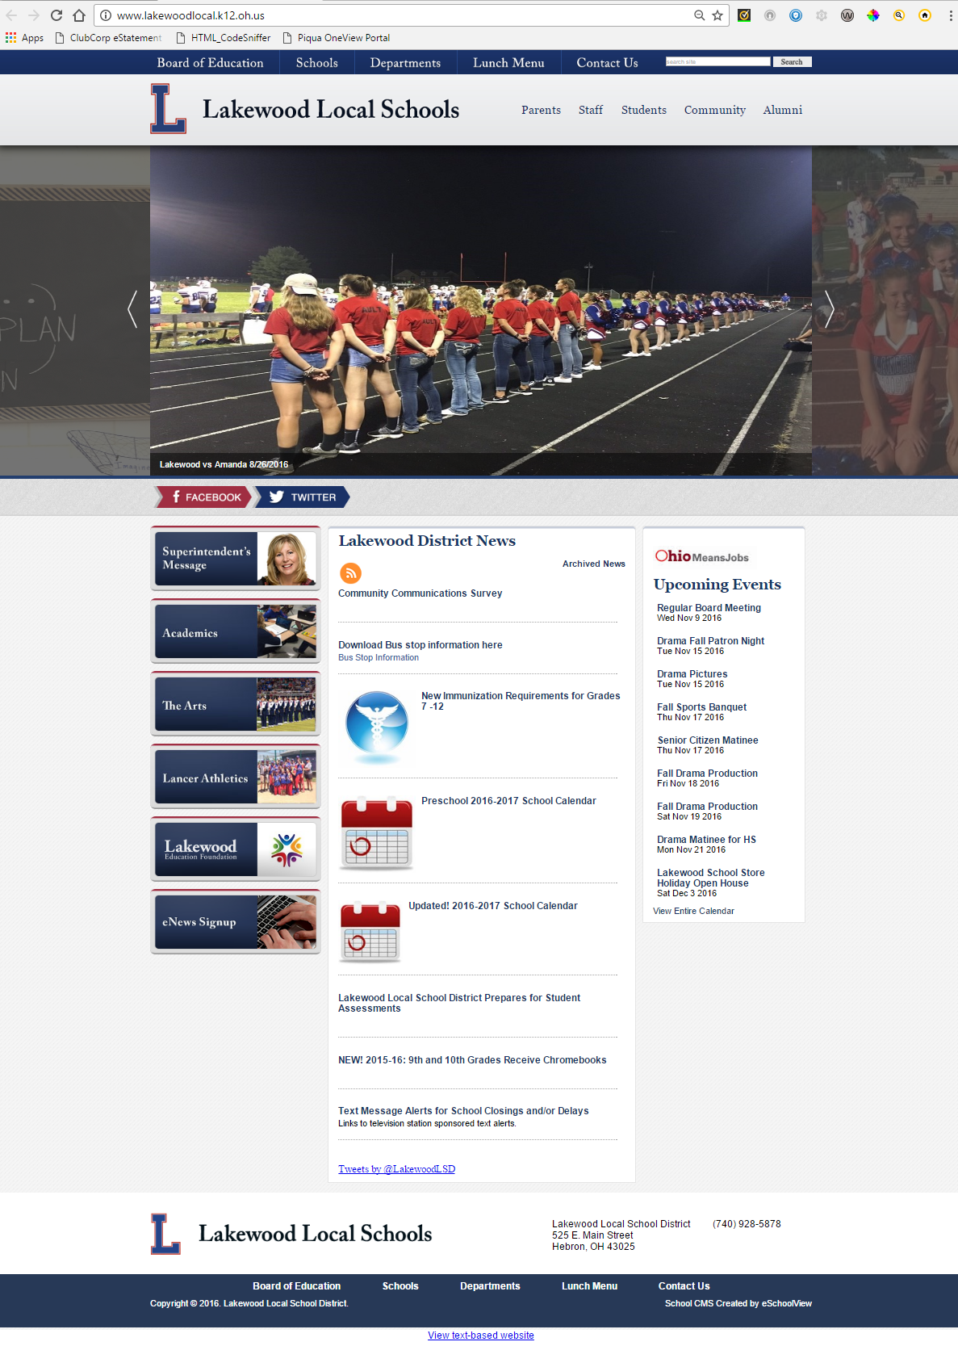
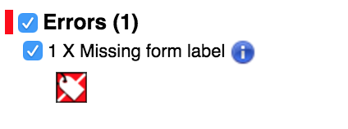
Examples of ADA Compliant sites
Pre fix results.
Post fix results.
Only error is based on a 3rd party search tool that we do not have access to change source code.

Slide 40
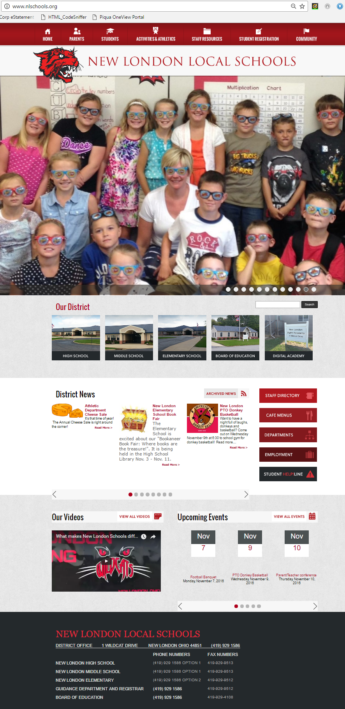
Examples of ADA Compliant sites
Pre fix results.
Post fix results.

Slide 41
What to do NOW?
Establish a District policy for compliance
Staff Development for Website users
Ensure you have a system-CMS that can support Compliance
Complete a Compliance audit on your website
Website Feedback
Stay close to your users

Slide 42
What is Public Facing
Pdfs, word docs, powerpoint and other documents
Webpage content
Social media (twitter, facebook) as well as other third-party content
Multimedia (imbedded video feeds)
lms

Slide 43
Well it is not Public Facing… so I am all good
SIMPLE ANSWER IS NO
Intranet content
Staff forms
Staff training (lMS/PD)
This also includes student content

Slide 44
Two Things to think about
The Department of Justice announced that it will take another three years to develop the proposed regulations for making websites accessible to the disabled that will comply with the Americans with Disabilities Act. (http://www.lexology.com/library/detail.aspx?g=20996357-e482-47fa-a02f-7fbcee6d4316)
The U.S. Department of Justice (DOJ), which enforces Title III, received 6,391 accessibility complaints in fiscal year 2015 – representing a 40% increase over claims in the prior fiscal year. (https://www.littler.com/publication-press/publication/wave-website-and-other-ada-accessibility-claims-%E2%80%93-what-you-should-know)

Slide 45
A few popular screen readers to research are
BrowseAloud
Chromevox
JAWS
Lynx
NVDA
Window-Eyes

Slide 46
What is likely missing
AUDIO DESCRIPTIONS IN VIDEOS
CAPTIONS ON VIDEOS
ACCESS TO CONTROL PANELS ON VIDEOS
ALTERNATIVE TEXT ON IMAGES
Contrast between colors in the background and foreground (not just want you see but what does the code say)
DOCUMENTS POSTED IN AN INACCESSIBLE FORMAT
(code behind the screen) IMPROPERLY STRUCTURED DATA TABLES
IMPROPERLY FORMATTED AND LABELED FORM FIELDS
Notes:
LACK OF AUDIO DESCRIPTIONS IN VIDEOS
• If significant information that is presented visually within a
video is not discernable from the dialogue or audio track, audio
descriptions (verbal descriptions of the actions and images in
the video) must be included in order to allow individuals who
are blind or have low vision to access the information.
• Solution: Include Audio Descriptions and Captions
• Videos need to incorporate features that make them
accessible to everyone. Provide audio descriptions of images
(including changes in setting, gestures, and other details).
• Provide text captions synchronized with the video images to
make videos and audio tracks accessible to people who are
deaf or hard of hearing.
LACK OF CAPTIONS ON VIDEOS
All videos should be captioned.
• Captions should provide a verbatim, textual equivalent of the
auditory information and should be synchronized so that a
person reading captions can watch the speakers on the video
and associate the speech with relevant body language.
• Schools should be wary of using the default YouTube captions,
as they may be incomplete or inaccurate.
LACK OF ACCESS TO CONTROL PANELS ON VIDEOS
• When a video’s control panel (play, stop, volume, etc.) can only
be seen when the user’s mouse hovers over the video, keyboard
users may not be able to see or interact with the controls.
• Solution: Control panels must be accessible by keyboard users
and must be properly identified to allow those using assistive
technology to operate the controls.
LACK OF ALTERNATIVE TEXT ON IMAGES
• Assistive technologies (such as screen reading software and
refreshable Braille displays) utilized by people who are blind,
have low vision, or have other disabilities that affect their
ability to read a computer display cannot translate images into
speech or Braille.
• Because they only read text, screen readers and refreshable
Braille displays cannot interpret photographs, charts, colorcoded
information, or other graphic elements on a webpage.
• Solution: Add a Text Equivalent Description to Every
Image.
DOCUMENTS POSTED IN AN INACCESSIBLE FORMAT
• PDF documents are often not accessible by people who need
to use screen readers, text enlargement programs, and/or
different color and font settings to read computer displays.
• Documents must contain embedded text either by converting
from an electronic source or applying optical character
resolution so that screen readers are able to copy or extract the
document’s text.
• Solution: Post Documents in a Text-Based Format.
• Provide documents in an alternative text-based format, such
as HTML or RTF (Rich Text Format), in addition to PDF.
• Text-based formats are the most compatible with assistive
technologies.
IMPROPERLY STRUCTURED DATA TABLES
• In order for data tables to be appropriately accessible to
students using screen readers, the tables must have the proper
markup designation in HyperText Markup Language (HTML).
• This allows users of screen readers to hear the column and
row headers spoken to them as they navigate through each cell
of a data table.
IMPROPERLY FORMATTED AND LABELED FORM FIELDS
• Forms should allow people utilizing assistive technology to
access the information, field elements, and functionality
required for completion and submission of the form.
• For example, if the first box of a form asks for a student’s first
name, the words “first name” should be associated with the
input box; otherwise, someone using assistive technology
would not know what information should be typed in the box.
IMPROPER CONTRAST BETWEEN BACKGROUND AND FOREGROUND COLORS
• Color and font settings on each web page must be able to be
manipulated so that users with low vision can make pages
readable.
• Solution: Avoid Dictating Colors and Font Settings
• Websites should be designed so they can be viewed with the
color and font sizes set in users’ web browsers and operating
systems.
• Users with low vision must be able to specify the text and
background colors as well as the font sizes needed to see
webpage content.

Slide 47
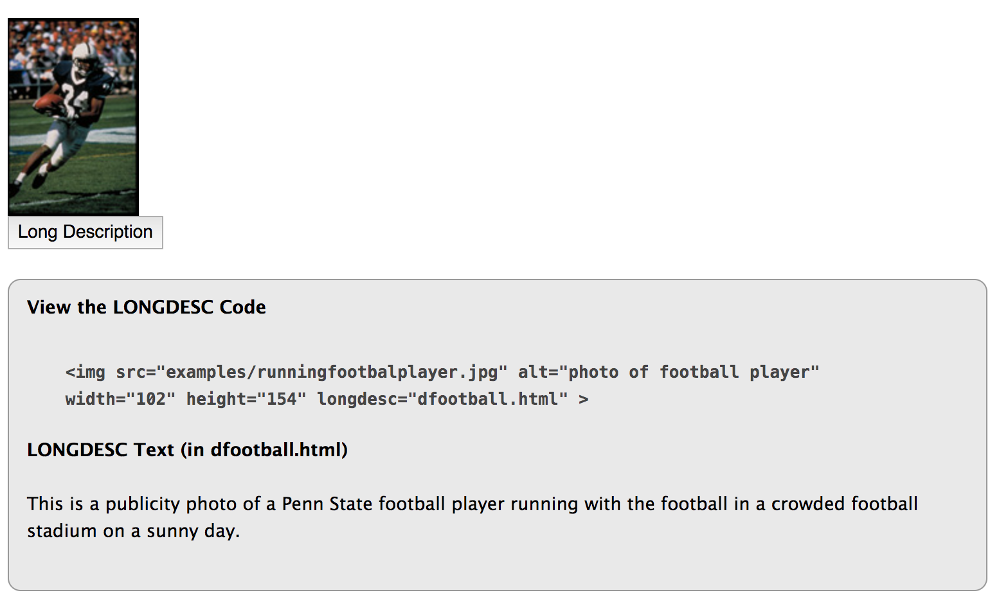
ALT Tag sample Long Descriptions
It’s recommended that ALT tags be limited to about 125 characters.
Alt text with acronyms should be written with spaces in between letters. For instance, <alt="I T S at P S U" > (read by a screen reader as "ITS at PSU") is preferable to <alt="ITS at PSU" > (read as "It’s at Sue").
Notes:
The alt attribute should typically:
Be accurate and equivalent in presenting the same content and function of the image.
Be succinct. This means the correct content (if there is content) and function (if there is a function) of the image should be presented as succinctly as is appropriate. Typically no more than a few words are necessary, though rarely a short sentence or two may be appropriate.
NOT be redundant or provide the same information as text within the context of the image.
NOT use the phrases "image of ..." or "graphic of ..." to describe the image. It usually apparent to the user that it is an image. And if the image is conveying content, it is typically not necessary that the user know that it is an image that is conveying the content, as opposed to text. If the fact that an image is a photograph or illustration, etc. is important content, it may be useful to include this in alternative text.

Slide 48
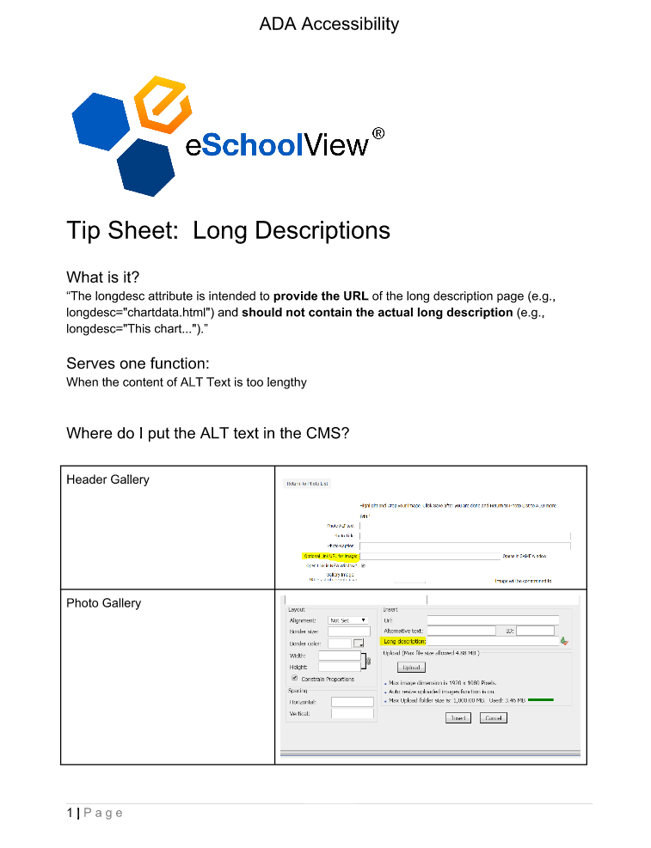

Slide 49
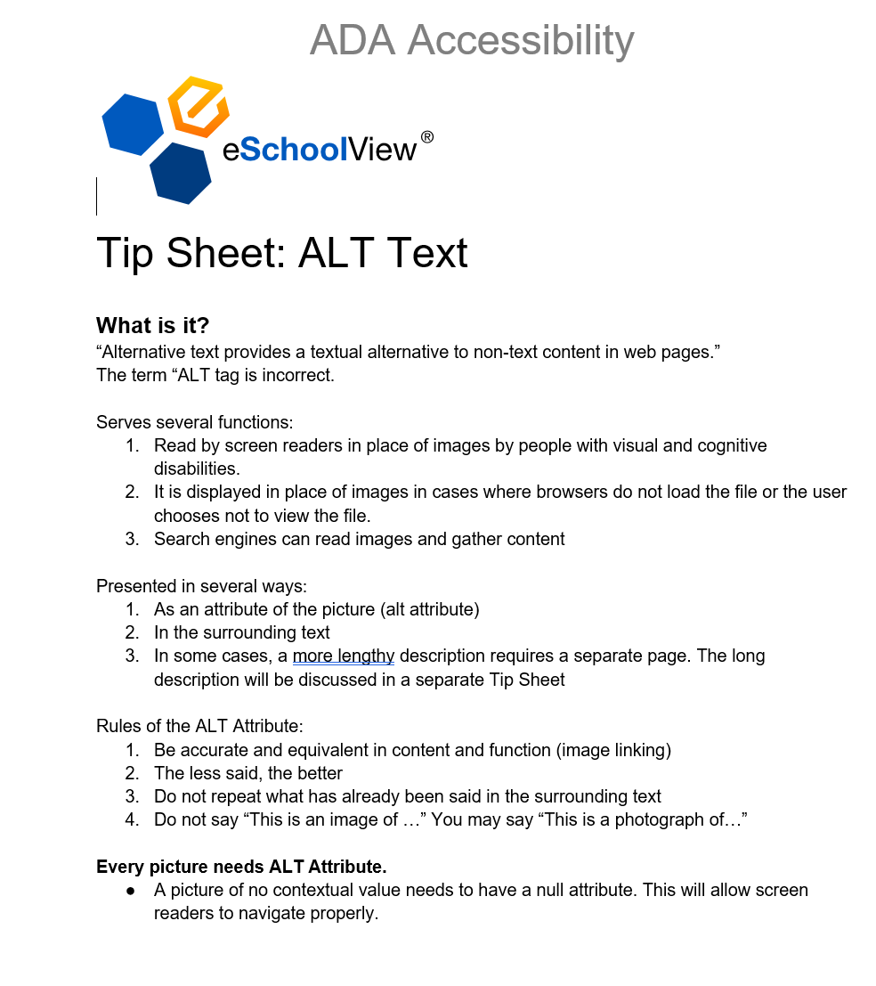
Notes:
The alt attribute should typically:
Be accurate and equivalent in presenting the same content and function of the image.
Be succinct. This means the correct content (if there is content) and function (if there is a function) of the image should be presented as succinctly as is appropriate. Typically no more than a few words are necessary, though rarely a short sentence or two may be appropriate.
NOT be redundant or provide the same information as text within the context of the image.
NOT use the phrases "image of ..." or "graphic of ..." to describe the image. It usually apparent to the user that it is an image. And if the image is conveying content, it is typically not necessary that the user know that it is an image that is conveying the content, as opposed to text. If the fact that an image is a photograph or illustration, etc. is important content, it may be useful to include this in alternative text.

Slide 50
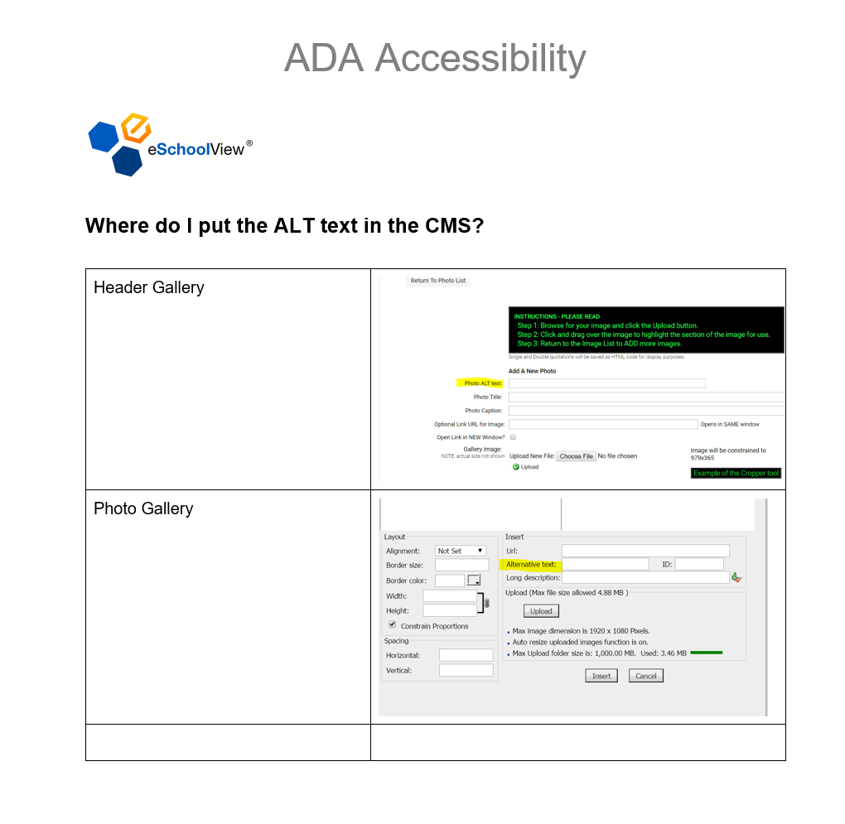
Notes:
The alt attribute should typically:
Be accurate and equivalent in presenting the same content and function of the image.
Be succinct. This means the correct content (if there is content) and function (if there is a function) of the image should be presented as succinctly as is appropriate. Typically no more than a few words are necessary, though rarely a short sentence or two may be appropriate.
NOT be redundant or provide the same information as text within the context of the image.
NOT use the phrases "image of ..." or "graphic of ..." to describe the image. It usually apparent to the user that it is an image. And if the image is conveying content, it is typically not necessary that the user know that it is an image that is conveying the content, as opposed to text. If the fact that an image is a photograph or illustration, etc. is important content, it may be useful to include this in alternative text.

Slide 52
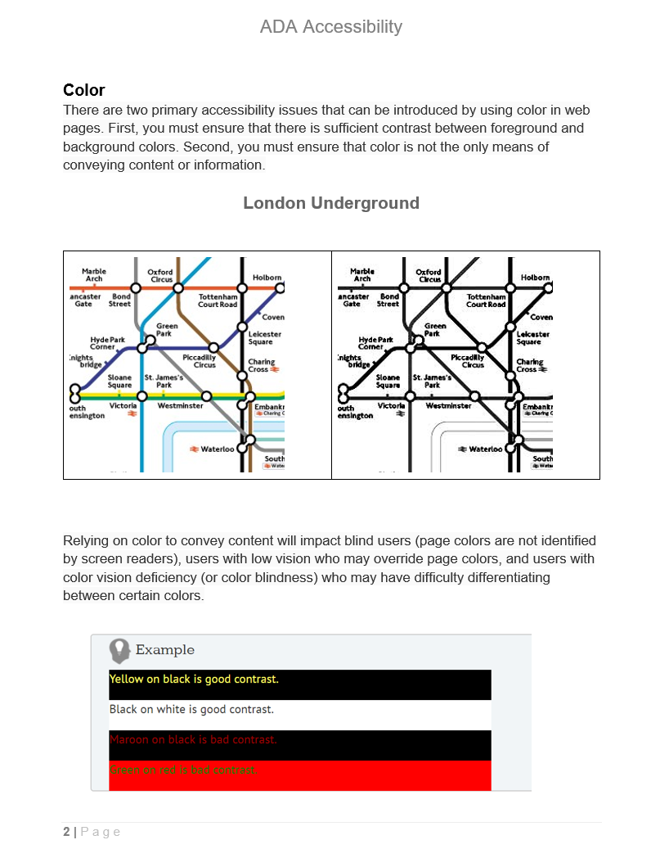

Slide 54
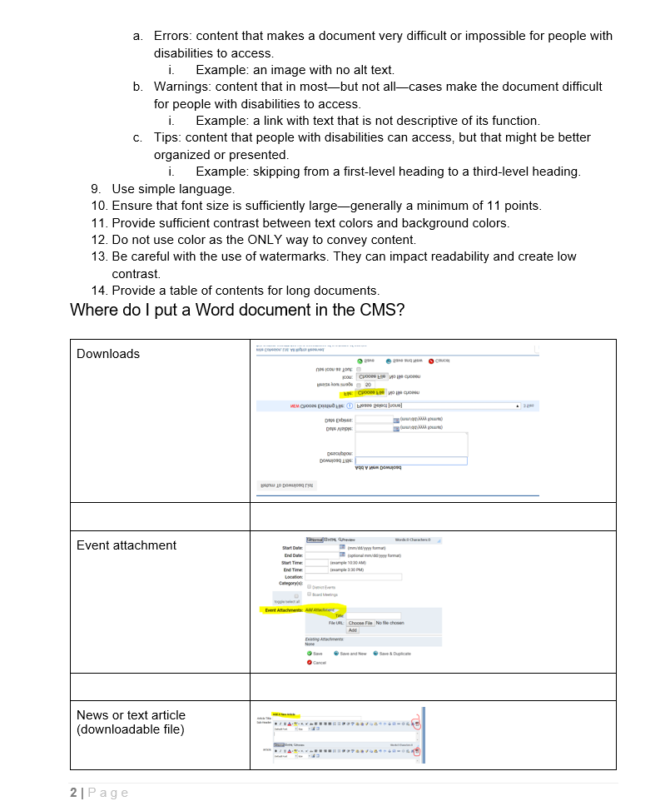

Slide 55
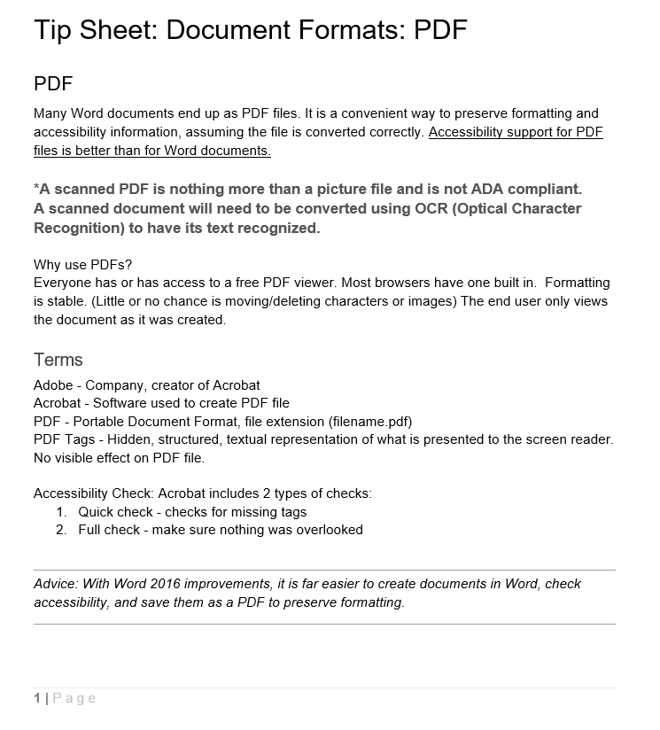

Slide 56
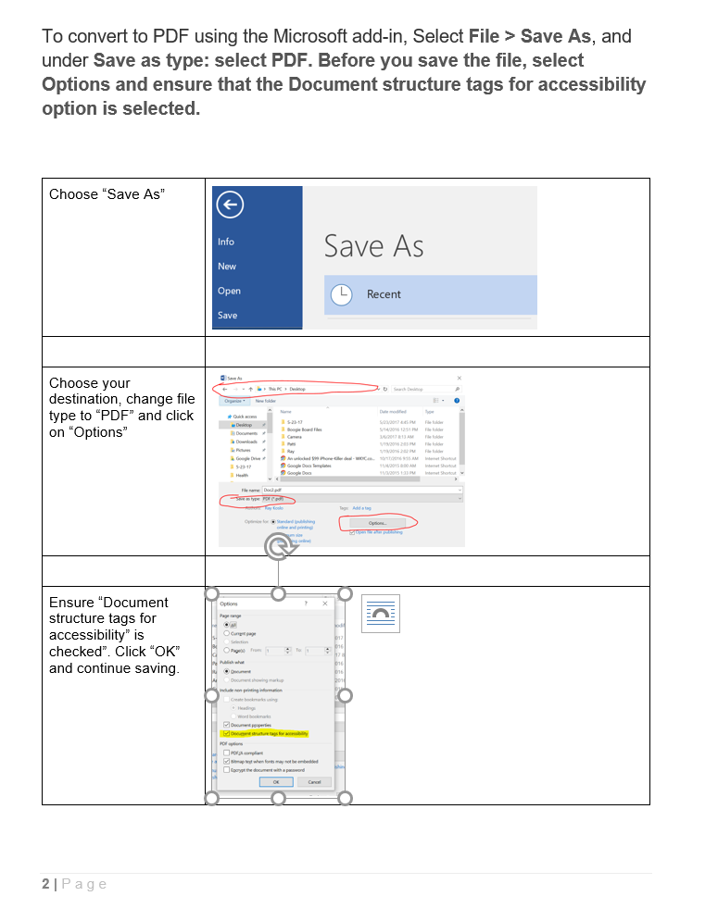

Slide 57
THANK you…

